Slide 1
Presented By:
Yash Jaiswal

Slide 2
Customer retention
1) Customer satisfaction
2) value for Money
3) repurchase
4) service quality, system quality, information quality
5) loyalty

Slide 3
INTRODUCTION
1) guarantee of success
2) key of Purchase
3) repurchase customer loyalty
4) review of the loyalty customer retention
5) trust and net benefit

Slide 4
PROBLEM STATEMENT
The research furthermore investigated the factors that influence the online customers repeat purchase intention. The combination of both utilitarian value and hedonistic values are needed to affect the repeat purchase intention (loyalty) positively. The data is collected from the Indian online shoppers. Results indicate the e-retail success factors, which are very much critical for customer satisfaction.

Slide 5
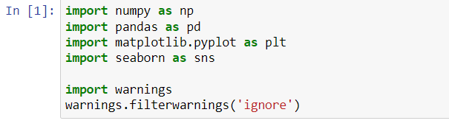
Libraries

Slide 6
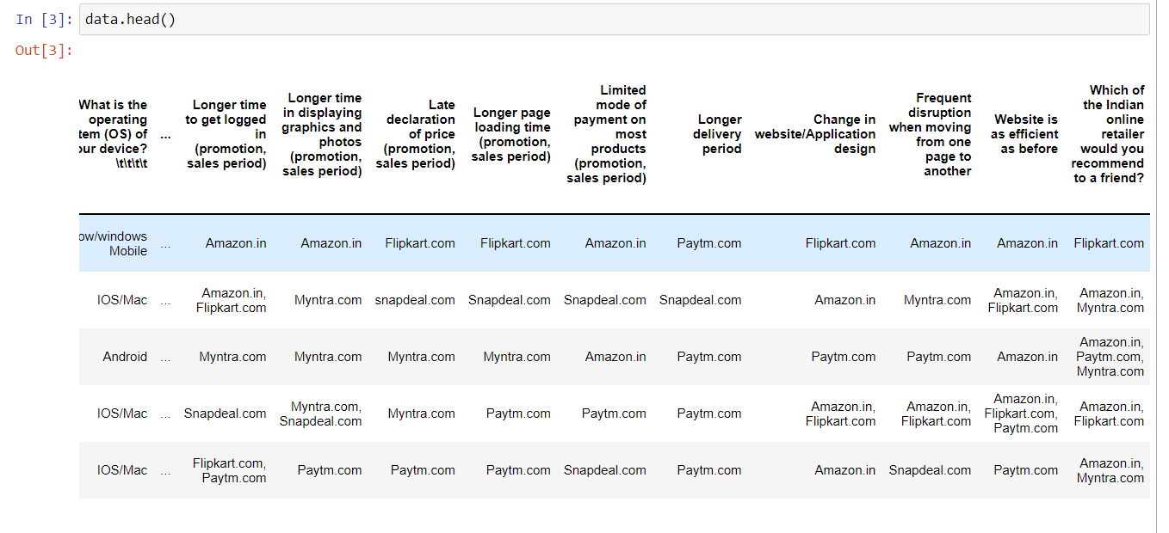
DATASET

Slide 7
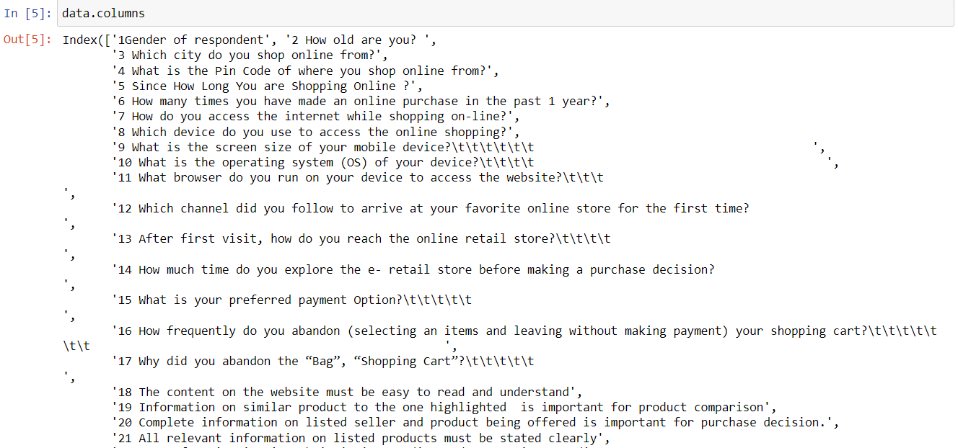
Columns

Slide 8
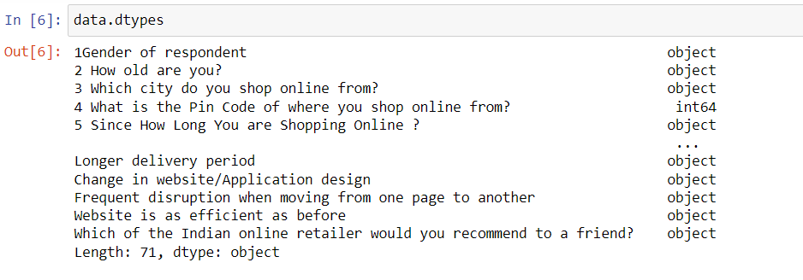
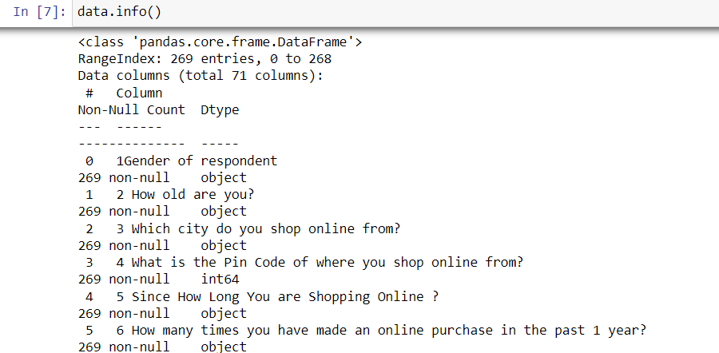
Exploratory Data Analysis(EDA)

Slide 9
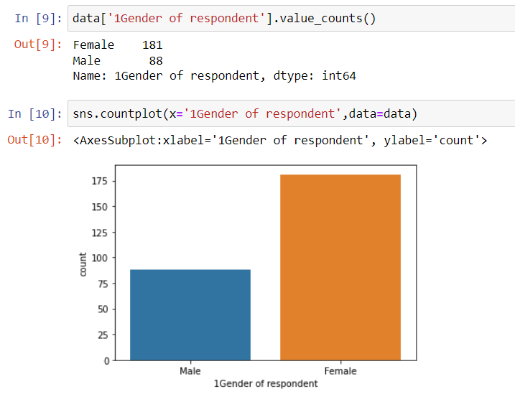
VISUALIZATIONS

Slide 10
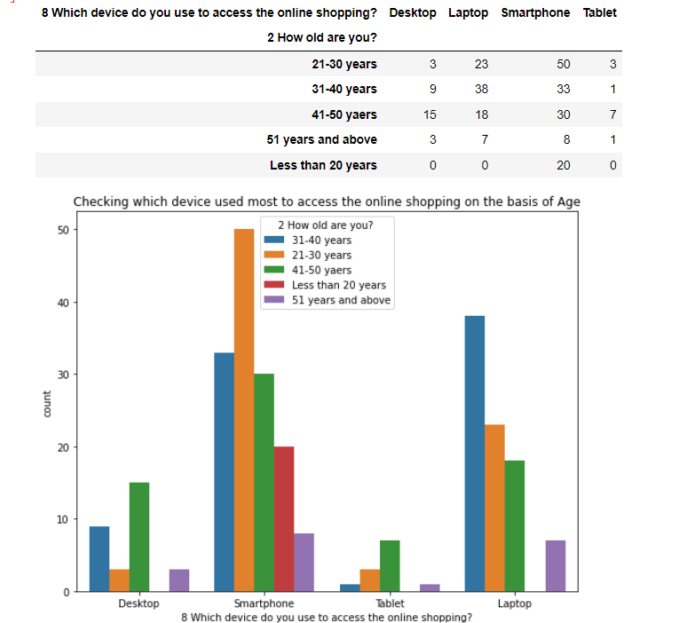
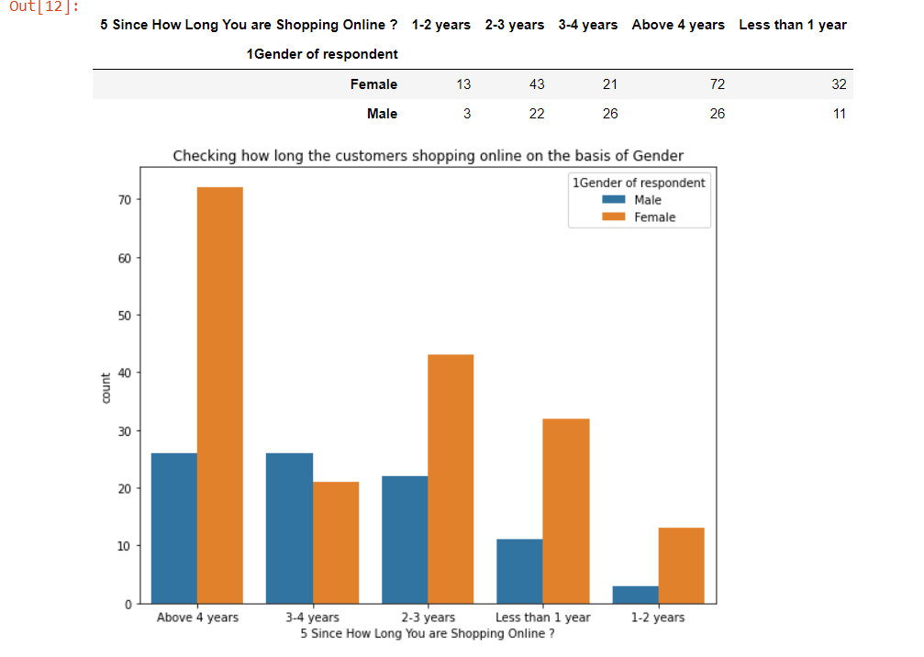
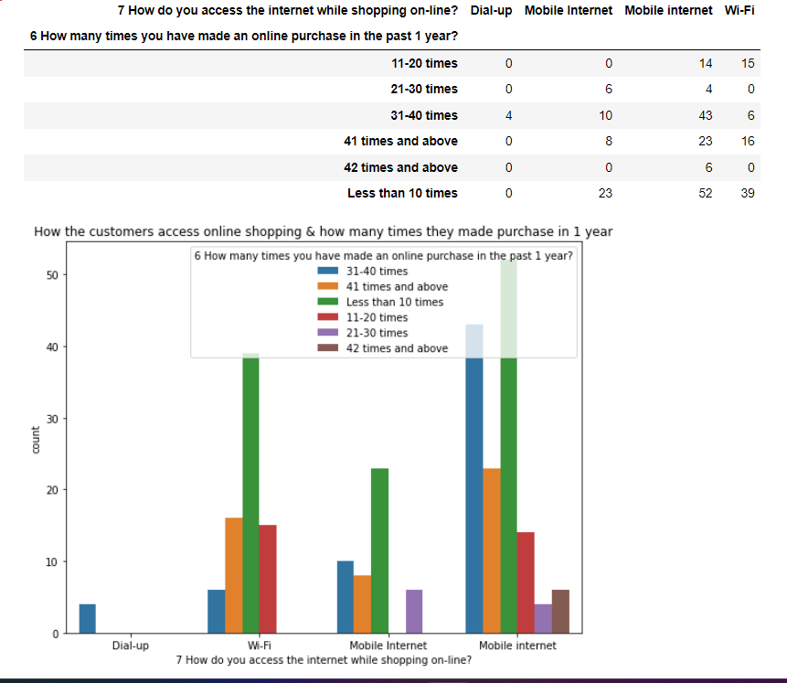
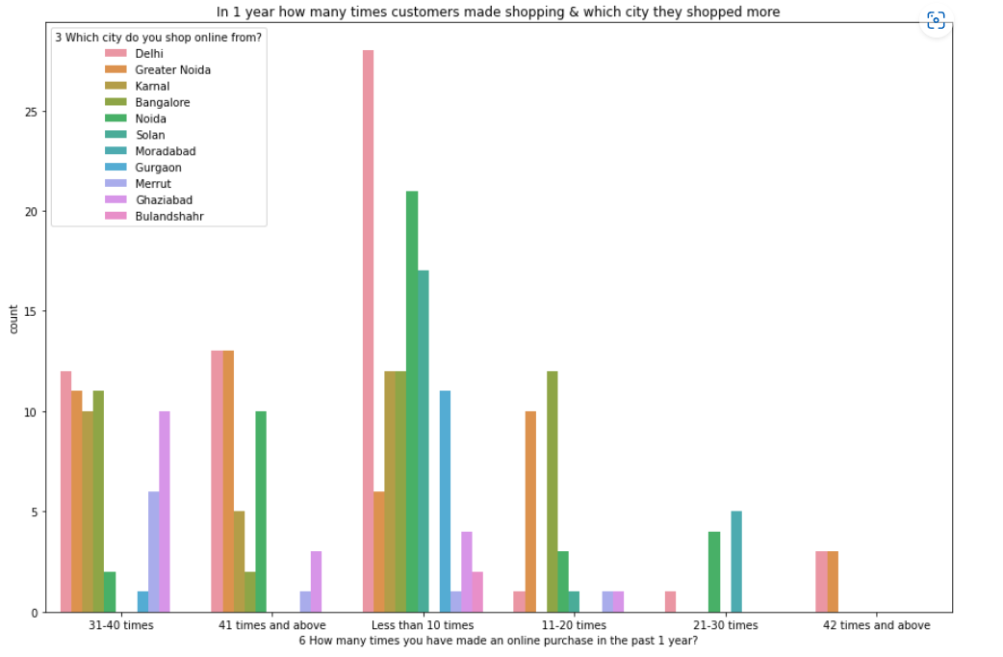

Slide 11
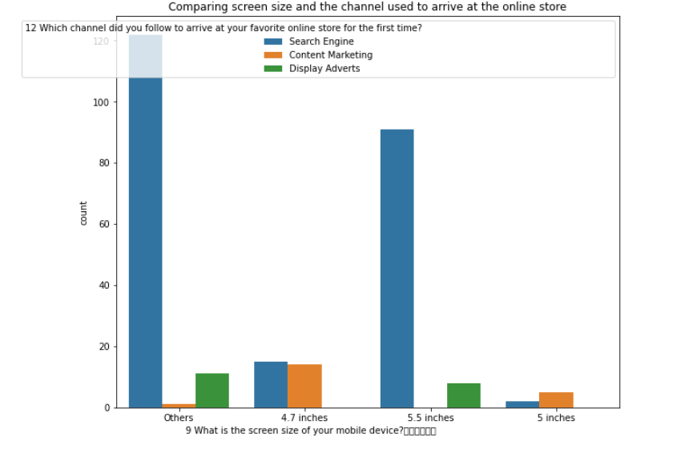
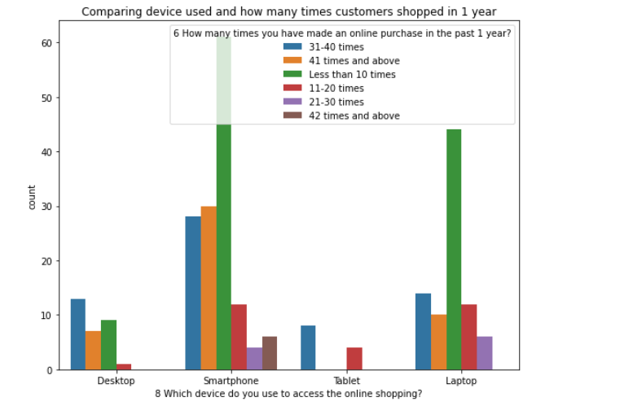
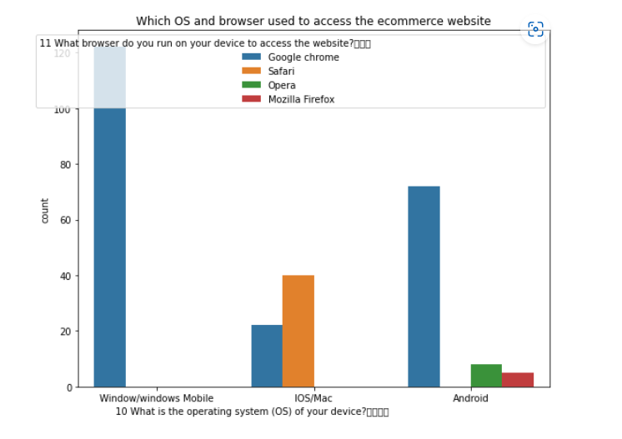
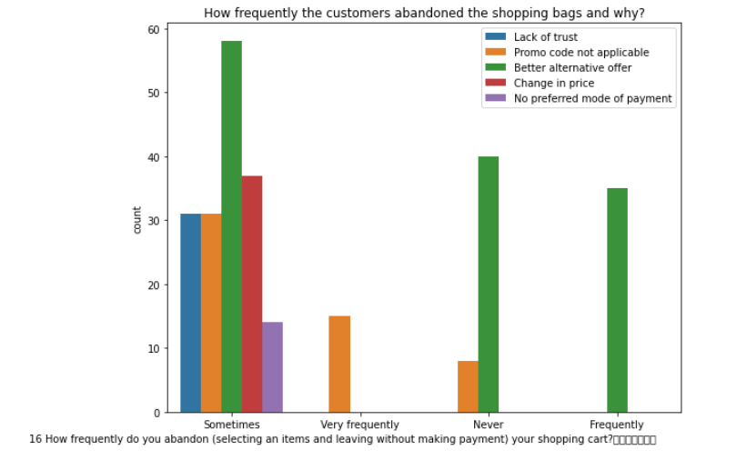

Slide 12
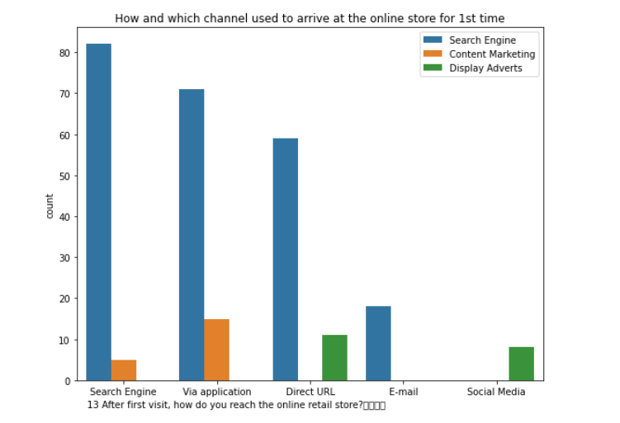
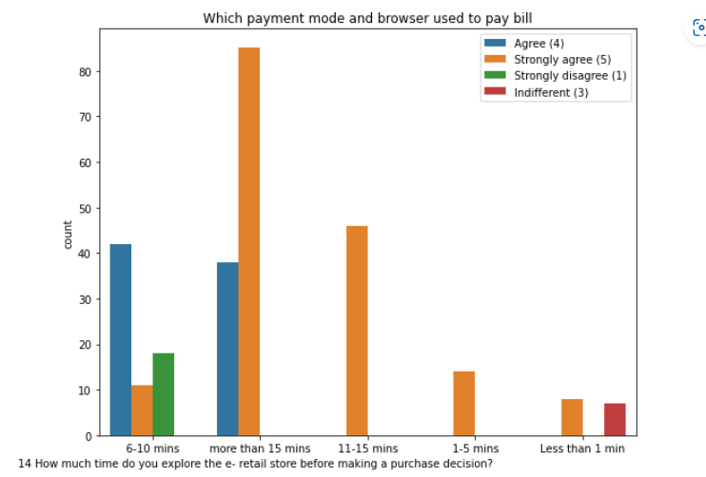
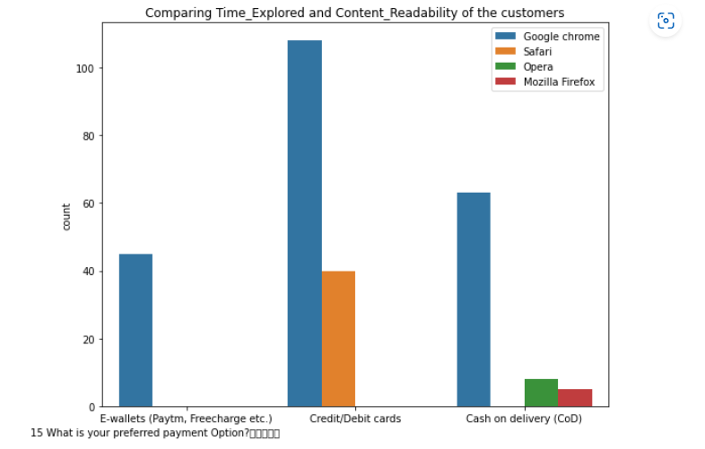
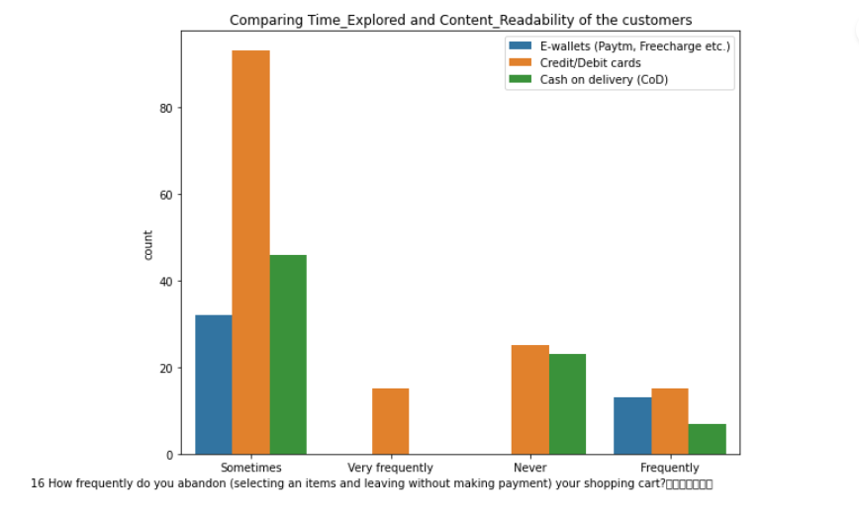

Slide 13
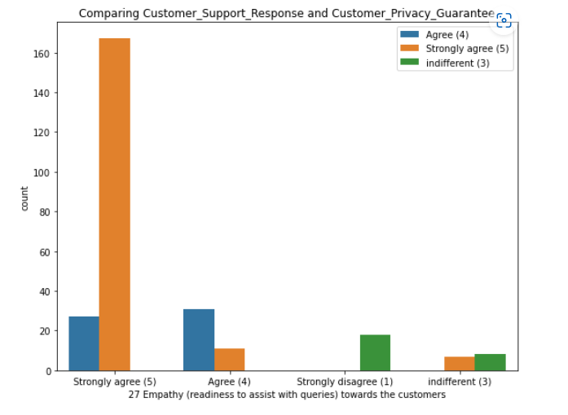
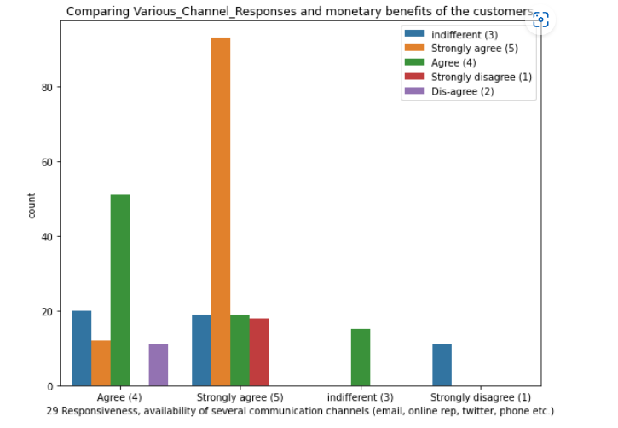
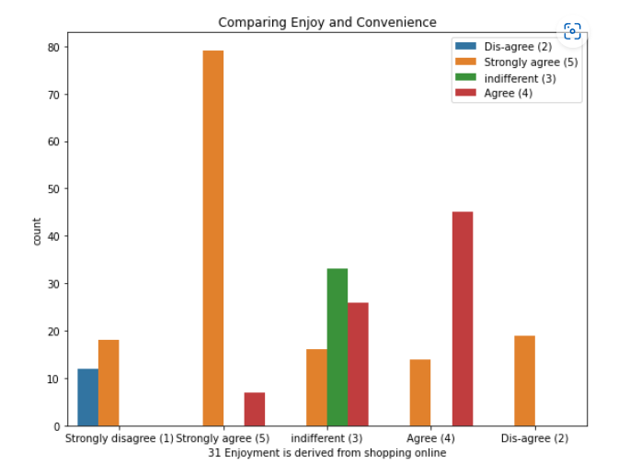
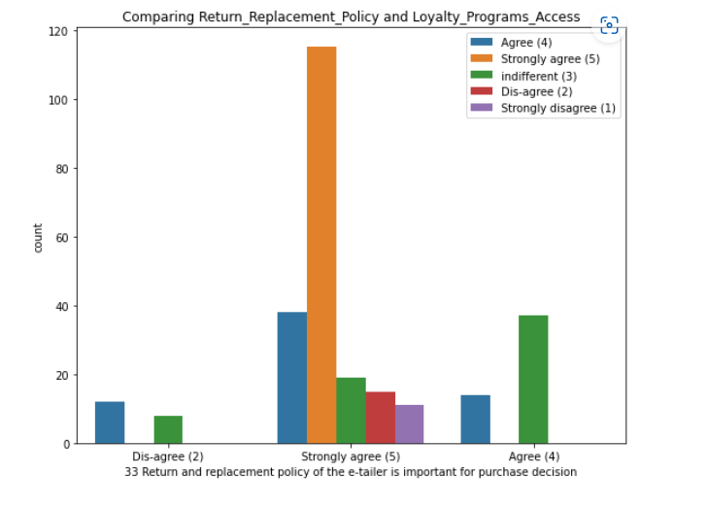

Slide 14
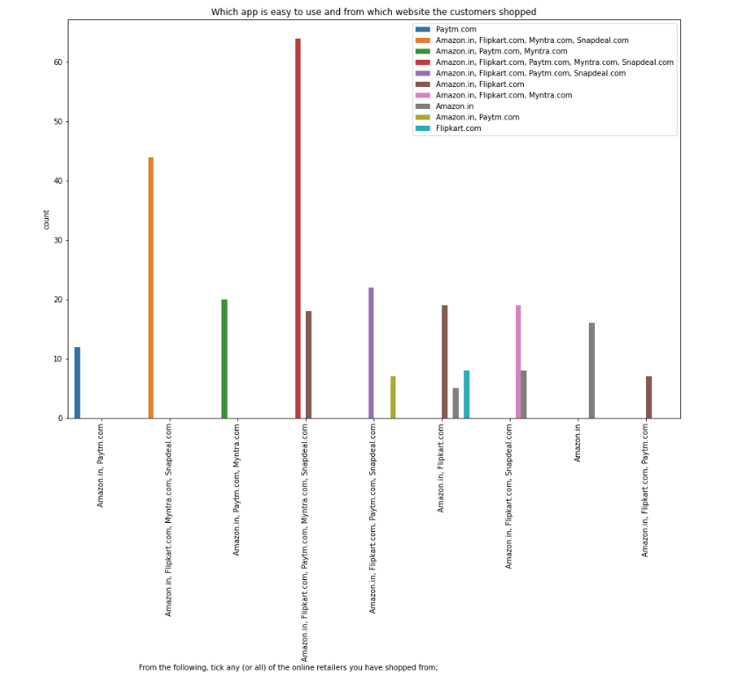
Which app is easy to use and from which website the customers shopped

Slide 15
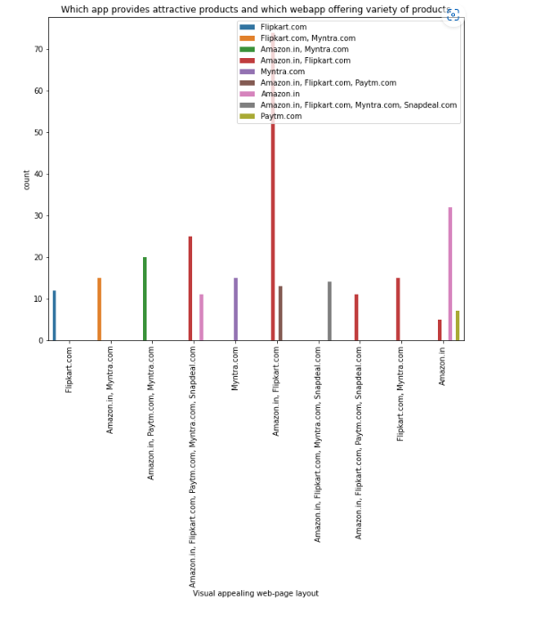
Which app provides attractive products and which webapp offering variety of products

Slide 16
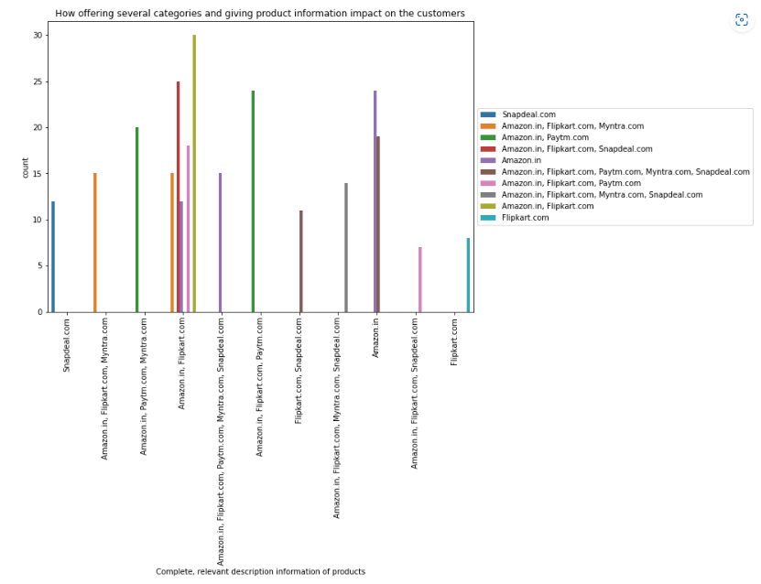
How offering several categories and giving product information impact on the customers

Slide 17
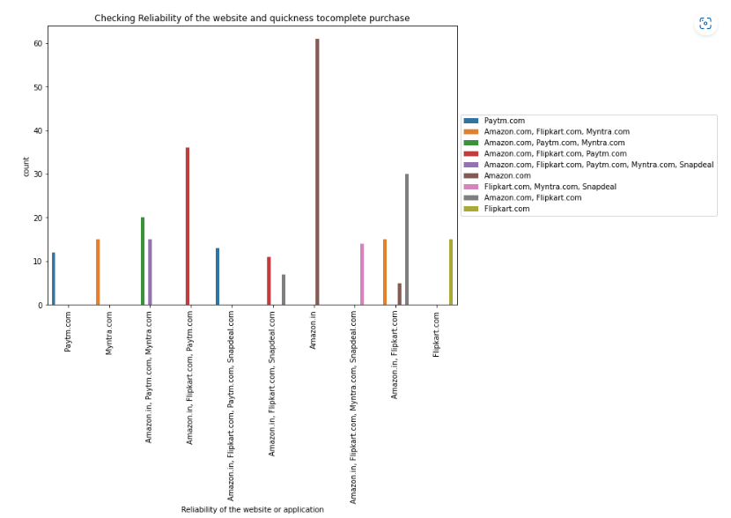
Checking Reliability of the website and quickness tocomplete purchase

Slide 18
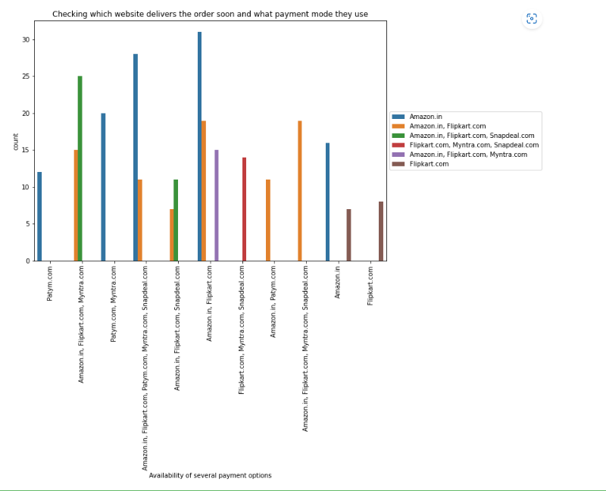
Checking which website delivers the order soon and what payment mode they use

Slide 19
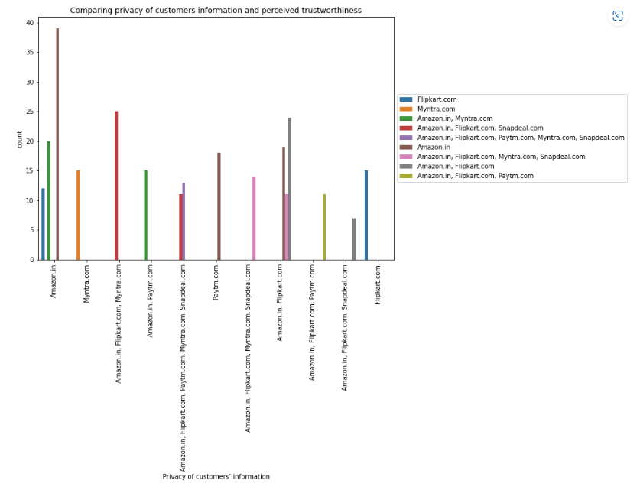
Comparing privacy of customers information and perceived trustworthiness

Slide 20
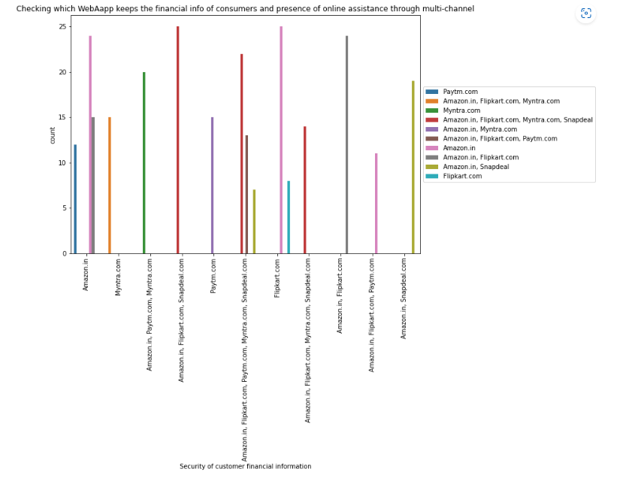
Checking which WebAapp keeps the financial info of consumers and presence of online assistance through multi-channel

Slide 21
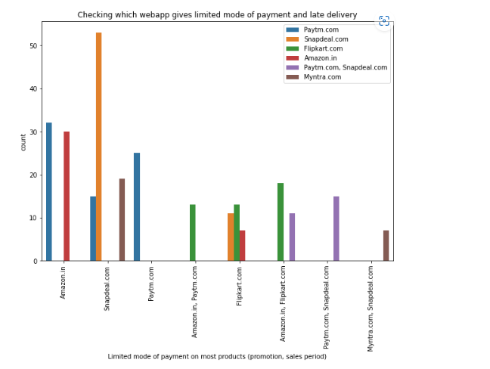
Checking which webapp gives limited mode of payment and late delivery

Slide 22
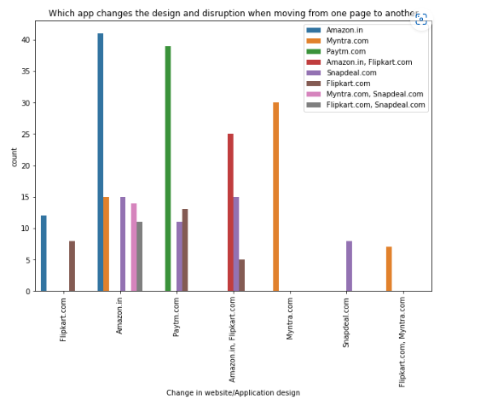
Which app changes the design and disruption when moving from one page to another

Slide 23
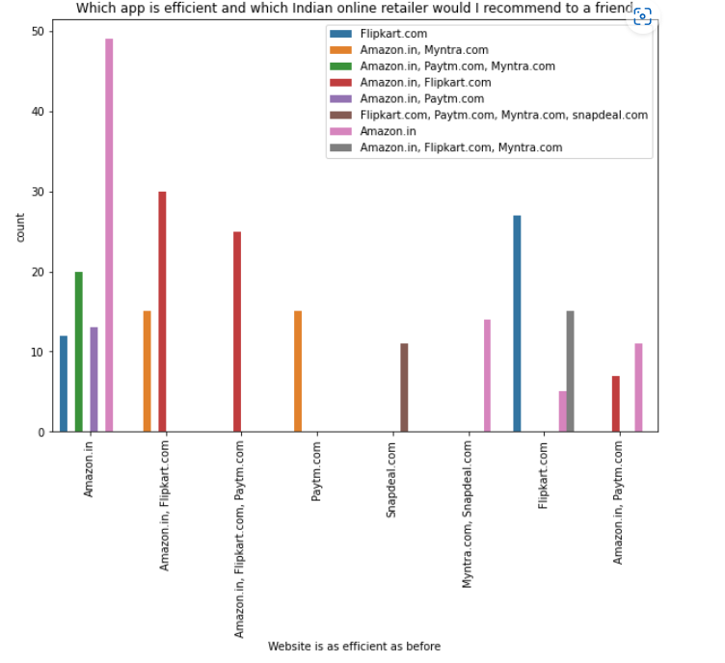
Which app is efficient and which Indian online retailer would I recommend to a friend

Slide 24
CONCLUSION
1) After visualizing the data. I found Amazon is the best online store
2) Where the customer trust on buying products and it has positive impact on the customer
3) customer satisfaction and customer trust appeared as the outcomes of overall e-retail factor

Slide 25
THANK YOU

